Slide 1
Personal/Professional Development Agent Training

Slide 2
Agent Profile
NAME:
AKA/Tagline :
Bio
Photo / Coat of Arms
or Ideal Picture
Streams of Understanding
Body
Interior
Communication
Relationships
Time
Things you Value in Others
Points of Pride in Yourself

Slide 3
Boosters/Brakes
Boosters | What | Who | Triggers | Related Stream
ex. Exercise | After I exercise I get energized to work | Usually I exercise alone | I get inspired to exercise on sunny days | Body
ex. Late @ Night | From 10pm - 2 am | Self | Don't Know (seems random) | Don’t Know
ex. Music | Techno or Instrumental | Self | When I feel like pounding out lots of small tasks | Interior
Brakes | What | Who | Interrupts | Related Stream
ex. Conflict with Family | Any unresolved family conflict | Usually with spouse/parent | Can be cut off by keeping area clean | Relationships, Temporal
ex. Interruptions | Phone calls, Instant Messenger, Facebook | Usually friends, occasionally business | No Internet connection | Communication, Relationships, Interior
ex. Bad News | Any negative circumstance | Self or Loved one | Don't know | Don't Know

Slide 4
Three Key Missions
Freedom
From Self
Give Your Gift
Find Your Purpose

Slide 5
Mission Progress
The First Quest: Freedom from Self
Constraint
Dishonesty
Conflict
Freedom
Authenticity
Peace
Anger, Frustration, Fear
Clarity, Joy, Energy
The Second Quest: Finding your Purpose
Hollow
Futility
Depth
Meaning
The Third Quest: Giving your Gift
Gain Centric
Stagnation
Mission Centric
Growth
Where are you on your quests? Put a big X where you think you are presently on each of these. Some may be further along than others. They may, or may not ever be complete – the point is to identify where you are and work to a plan forward. With your streams and your boosters as a guide

Slide 6
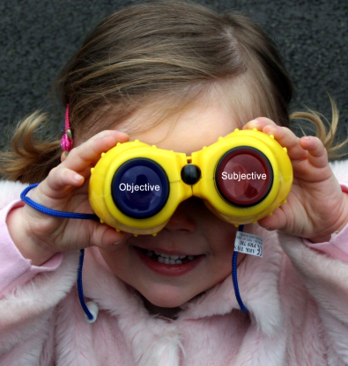
Perspectives
Values
Definition
Data
True/False
Facts
Dimensions
Outcomes
Talks to
Operates on
Objects
Now in
3 – D!
Meaning
Interpretation
Feelings
Subtlety
Contexts
Perspectives
Expression
Communes With
Subjects

Slide 7
1st Quest Helper
Discover your baggage
I awake in the _______ feeling ________. I think this is because of the ________ I had the _________ before.
I can’t be sure, but sometimes I think that my _________ ___________me. I f only _______ could ______ I would be ___________.
If only I had more ________ I could truly be happy.
I _______ myself. When it’s all said and done I expect to _________ because ________.
If only ______________ then ___________.
If only ______________ then ___________.
If only ______________ then ___________.
Get in touch with what is holding you back or keeping you constrained using these MadLibs style sentences. Be as honest as you can here. Fill in the blanks and evaluate your emotional response to the words as you write them. The greater the charge, the more likely that further reflection is warranted. Get the baggage out by putting it on paper in the form of your “if only” statements. For real impact try reading one of your sentences out loud.

Slide 8
1st Quest Helper
Identifying new behaviors
Adaptations / Adaptive Behaviors
You are here
Past
Future
Compromises / Maladaptive Behaviors
Work on past adaptations and compromises first. After filling this out, verify that adaptations are truly positive and not compromises in disguise.
Fill out future adaptations and compromises that you expect to make. Are the future behaviors you need to require related to your current skills or are they new? Which developmental stream will you need to work on?
How will you adapt?

Slide 9
1st Quest Helper
Identifying new beliefs
Hopeful/Neutral Beliefs
You are here
Past
Future
Cynical/Painful Beliefs
Work on past beliefs first. After filling this out – reflect on the things you believe. Document the beliefs you think will serve you in the future on the right hand side of the page.
Use these future beliefs to inform your 2nd Quest Helper: Noals are not Goals

Slide 10
2nd Quest Helper
Noals are not Goals
Behaviors I want to have
Knowledge/Skills I want to have
Beliefs I want to have
Use this sheet to get a the intangible changes you want to become a part of your experience. Try to phrase these in the form of positive statements rather than negative ones. These may inform goals later – but stand independently as part of your personal vision of the future.

